Slide 1


Overview of Brazilian PT program
Brazilian Experience
Renata Cristina Messores Rudolf
Laboratory of Molecular Biology, Microbiology and Serology (LBMMS)

Slide 2

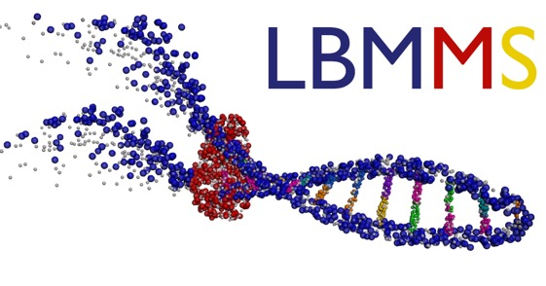



Overview of Brazilian PT program
Brazilian Rapid Test Continuous Quality Improvement
Panel production
Laboratory of Molecular Biology, Microbiology and Serology

Slide 3
Overview of Brazilian PT program
Free proficiency test for the public healthcare services
Continuous (long-term follow-up)
Educational character (non-punitive)
Evaluates each healthcare professional individually

Slide 4
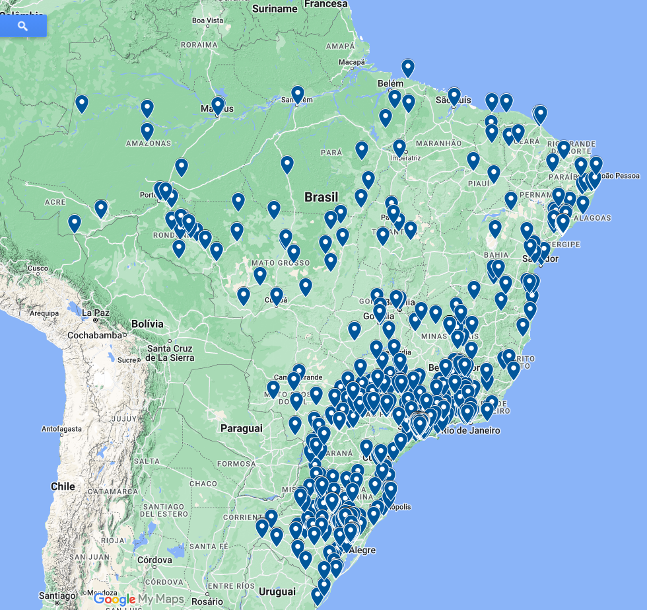

Overview of Brazilian PT program
Registered Health Units: 1,773
primary health care units
specialized services
hospitals and maternity
indigenous health districts
laboratories
Health Professionals registered in the program: 7,288
Panels per round: 4,100
80% nursing professionals

Slide 5
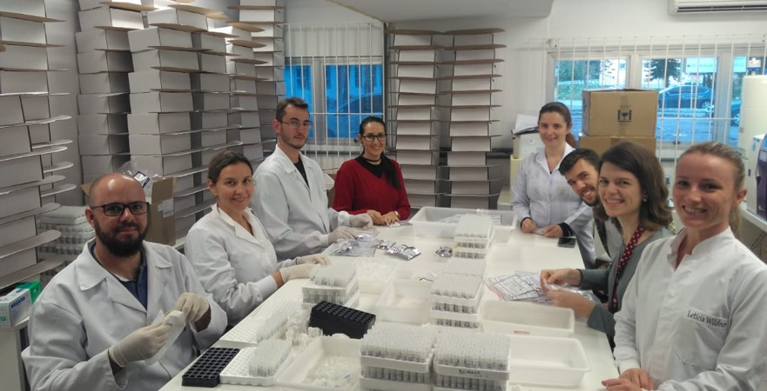
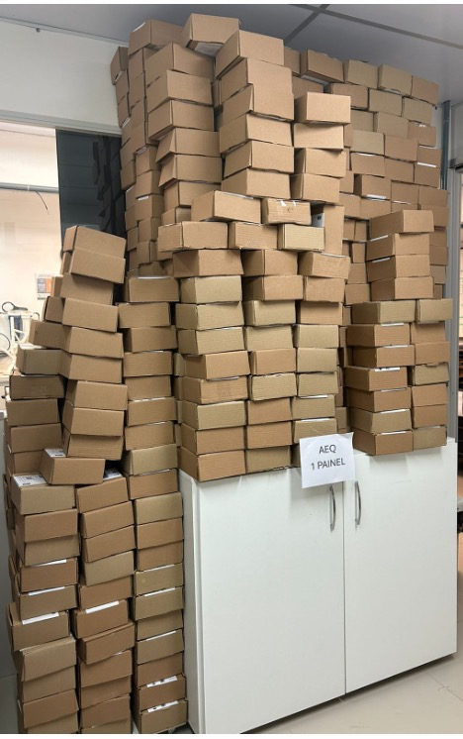
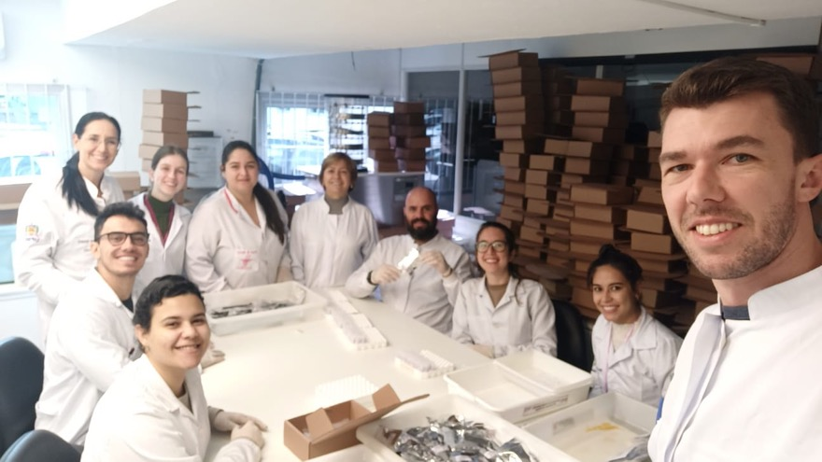
Panels production

Slide 6
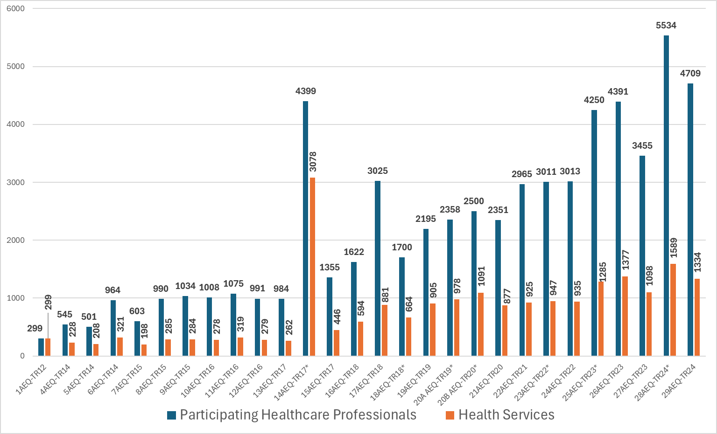
Overview of Brazilian PT program

Slide 7

Overview of Brazilian PT program

Slide 8
Overview of Brazilian PT program
Healthcare Professionals registered in the program: 7,288
Healthcare Professionals participating in the last round: 4,709
Some of them do not participate in the rounds due to:
vacation
maternity leave
retirement
leave due to health problems
health care units registration not updated
panels shipped and unused

Slide 9

Overview of Brazilian PT program
Theoretical rounds
One per year
Questionnaire on the execution of RT and procedures recommended in the Brazilian Diagnostic Technical Manuals
30 days

Slide 10
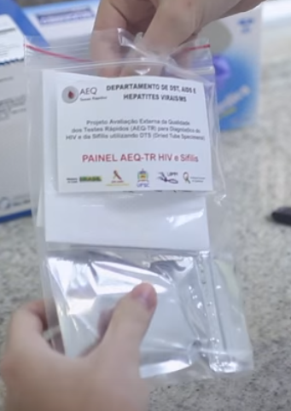
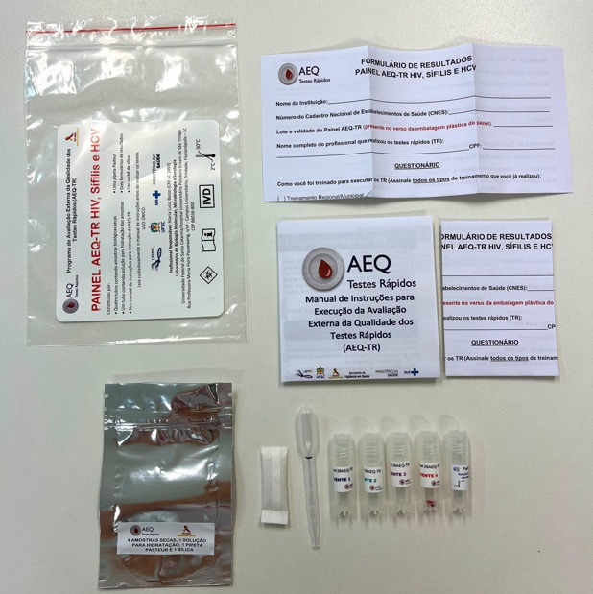
Overview of Brazilian PT program
Practice rounds
Twice a year
Execution of rapid tests for HIV, syphilis and hepatitis C vírus (simultaneously) with four panel elements.
30 days

Slide 11
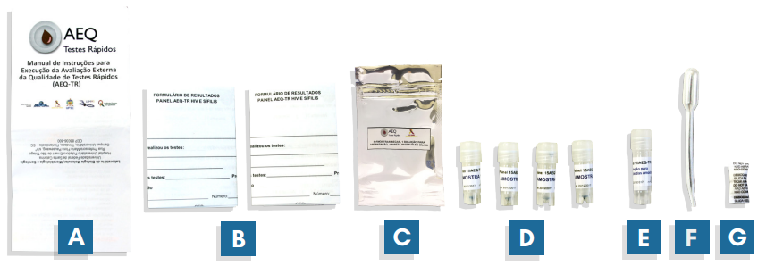
Overview of Brazilian PT program
Practice rounds
Dried Tubes Specimens (DTS)
Participants hydrate with PBS-TWEEN before use
A- instruction manual (mainly about the hydration process)
B- two results forms
C- metallic bag with hermetic closure (ziplock)
D- four serum or plasma samples with red dye (DTS methodology)
E- PBS-tween buffer
F- 0.5 mL pasteur pipette
G- silica sachet

Slide 12
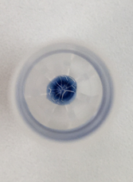
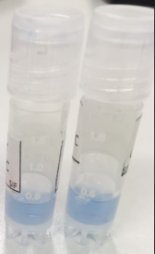
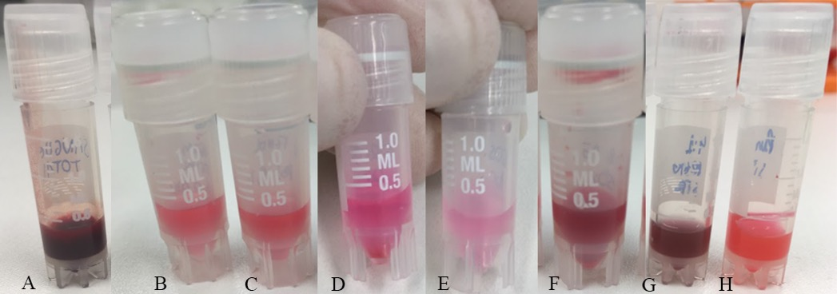

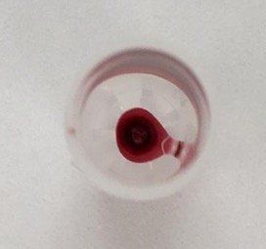
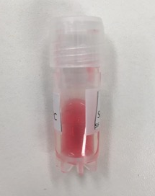
Overview of Brazilian PT program
Practice rounds
trypan blue dye
Adapted from Parekh et al, 2010 - green
A – Blood; B – Phenol Red + Water; C - Phenol Red + PBS; D – Erythrosine red; E – Eosin Y; F – Red food coloring powder; G – Liquid dye for paints (red and black); and H – Liquid dye for paints (red).

Slide 13
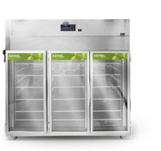
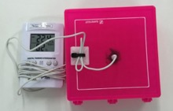
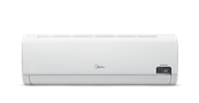
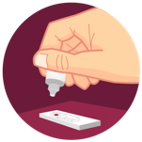

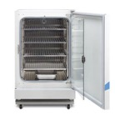
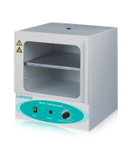
Overview of Brazilian PT program
Practice rounds
2ºC a 8ºC
Dry
21ºC a 25ºC
Tested: 1, 7, 14, 21, 28, 30, 35 and 40 days.
Temperatures
37 ºC
Rapid tests
Humid
42 ºC
Dye approval
40-day stability

Slide 14
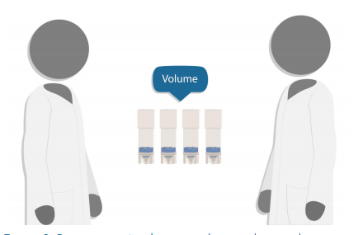
Overview of Brazilian PT program
Practice rounds

Slide 15
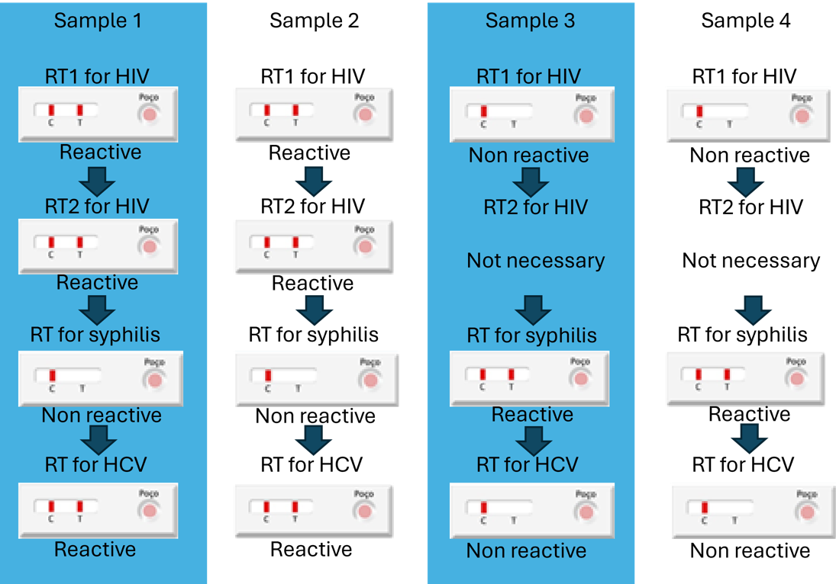
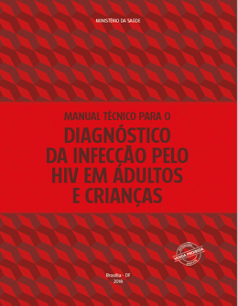
Overview of Brazilian PT program
Practice rounds
Anti-HIV Rapid Test
(RDT1)
Anti-HIV Rapid Test
(RDT2)
Positive
Positive

Slide 16
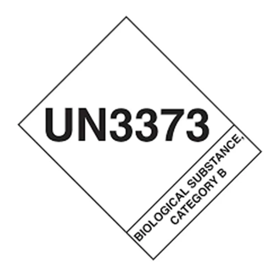

Overview of Brazilian PT program
Practice rounds
Transport via Brazilian Post Office

Slide 17
Overview of Brazilian PT program
Practice rounds
Evaluation criteria:
Each sample: 25 points
RT1 HIV: 70%
RT2 HIV: 30%

Slide 18
Overview of Brazilian PT program
Practice rounds
EXCELLENCE: 100% agreement
APPROVAL: 70 to 99% agreement
DISAPPROVAL:
agreement less than or equal to 69%;
use RT kits with an expired kits, regardless of the score obtained when performing the tests;
use the same diagnostic kit for RT1 and RT2 for HIV, regardless of the score obtained during the execution of the tests
PARTICIPATION:
use rapid test kit for oral fluid such as RT2
do not perform RT2 for HIV on samples reactive in RT1 for HIV
use an HIV self-test kit such as RT1 or RT2
use DUO HIV/Syphilis kit as RT2 for HIV

Slide 19
Overview of Brazilian PT program
Practice rounds - HIV
Round | EXCELLENCE | APPROVAL | DISAPPROVAL | PARTICIPATION
21EQA20 | 56,7% | 28,1% | 15,2% | 332 HP
22EQA21 | 63,9% | 24,5% | 11,6% | 310 HP
24EQA22 | 63,7% | 24,6% | 11,7% | 271 HP
26EQA23 | 57,3% | 30,4% | 12,4% | 498 HP
27EQA23 | 69,6% | 20,7% | 9,7% | 315 HP
29EQA24 | 68,3% | 23,4% | 8,3% | 376 HP
84,8%
88,4%
88,3%
87,7%
90,3%
91,7%
perform RT2 for HIV on samples non-reactive in RT1 for HIV
HP: healthcare professionals

Slide 20
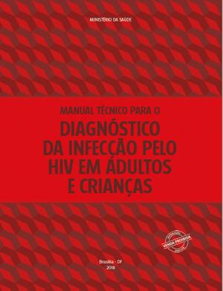
Overview of Brazilian PT program
Practice rounds - HIV
Round | EXCELLENCE | APPROVAL | DISAPPROVAL | PARTICIPATION
21EQA20 | 56,7% | 28,1% | 15,2% | 332 HP
22EQA21 | 63,9% | 24,5% | 11,6% | 310 HP
24EQA22 | 63,7% | 24,6% | 11,7% | 271 HP
26EQA23 | 57,3% | 30,4% | 12,4% | 498 HP
27EQA23 | 69,6% | 20,7% | 9,7% | 315 HP
29EQA24 | 68,3% | 23,4% | 8,3% | 376 HP
Anti-HIV Rapid Test
(RDT1)
Anti-HIV Rapid Test
(RDT2)
DISAPPROVAL:
agreement less than or equal to 69%;
use RT kits with an expired kits
use the same diagnostic kit for RT1 and RT2 for HIV
Positive
Positive
HIV positive sample

Slide 21
Overview of Brazilian PT program
Practice rounds - HIV
Round | EXCELLENCE | APPROVAL | DISAPPROVAL | PARTICIPATION
21EQA20 | 56,7% | 28,1% | 15,2% | 332 HP
22EQA21 | 63,9% | 24,5% | 11,6% | 310 HP
24EQA22 | 63,7% | 24,6% | 11,7% | 271 HP
26EQA23 | 57,3% | 30,4% | 12,4% | 498 HP
27EQA23 | 69,6% | 20,7% | 9,7% | 315 HP
29EQA24 | 68,3% | 23,4% | 8,3% | 376 HP
HP:
healthcare
professionals
PARTICIPATION:
use rapid test kit for oral fluid such as RT2
do not perform RT2 for HIV on samples reactive in RT1 for HIV
use an HIV self-test kit such as RT1 or RT2
use DUO HIV/Syphilis kit as RT2 for HIV

Slide 22
Overview of Brazilian PT program
Theoretical rounds - HIV
Round | EXCELLENCE | APPROVAL | DISAPPROVAL
23EQA | 20,2% | 64,7% | 15,1%
25EQA | 31,2% | 61,1% | 7,7%
28EQA | 7,6% | 66,7% | 25,7%
84,9%
92,3%
74,3%

Slide 23
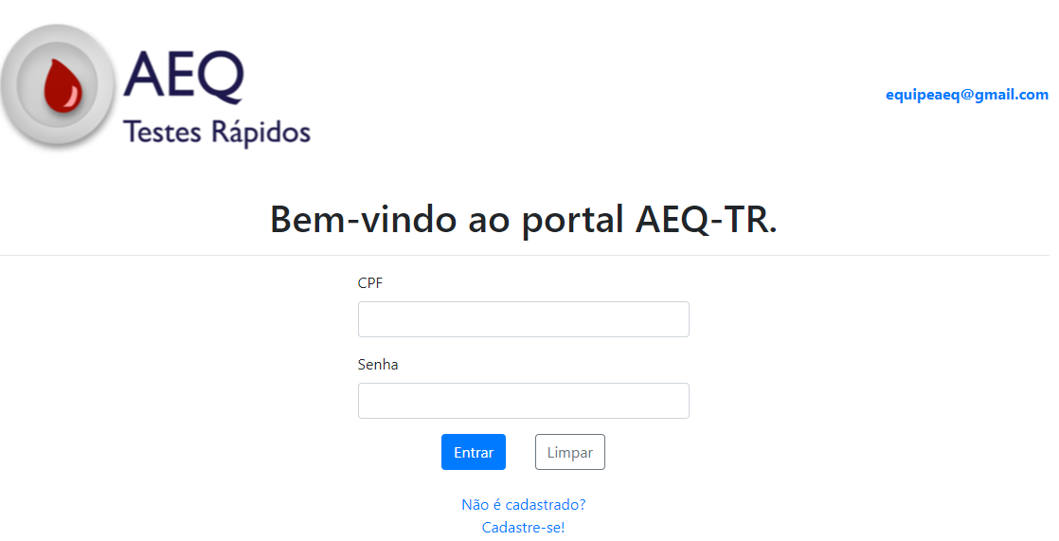
Practice rounds
Theoretical rounds
https://qualitr.paginas.ufsc.br/

Slide 24
Overview of Brazilian PT program
Scale up plans:
printing of the identification of the elements directly on the tubes (currently these are adhesive labels);
maintain actions to expand the number of professionals and services;
validation of the freezing of panel elements while maintaining the stability of the results (used successfully in round 29EQA24)
4,100 panels: 16,400 tubes + 4,100 PBS-TWEEN

Slide 25
aeq@aids.gov.br

